Slide 1




Referral Tools for the
Mental Health and Addictions (MH&A) Sector
Fall 2016

Slide 2
Intended Learning Outcomes
By the end of today’s session participants will:
Identify the partners / members of the working group
Identify the 2 new referral tools developed for the MH&A sector
Make and receive a referral using the MH&A Common Referral Form
Navigate Connect.Northeasthealthline.ca
Know that Connect.Northeasthealthline.ca houses information and referral tools to get connected or help connect others to BOTH Community Care Services and MH&A Services
Locate the Support Tools for use of the new referral tools
privacy responsibilities when using the referral tools

Slide 3
Your Team
ConnexOntario
Nicole Adkin
Ron Stewart
NE CCAC
Mathieu Litalien
NE LHIN
Jennifer Michaud
Mike O’Shea
Shana Calixte
System Navigation
Deana Stephen – Home and Community (CSS and CCAC) System Navigation
thehealthline.ca
Gabriele Davey
Neil Tuomi
Ryan Marttala
MH&A Service Providers
Angèle Desormeau – South Cochrane Addictions
Lisa Case – Sault Area Hospital
Rhea Funnell – CMHA Nipissing
Kali Sohm – CMHA Nipissing
Anne Sprack – Health Sciences North

Slide 4

WHAT are we trying to achieve?
Streamlined access to MH&A from:
                Acute Care
                Primary Care
                Home and Community Care (CSS and CCAC)
                Mental Health and Addictions

Slide 5
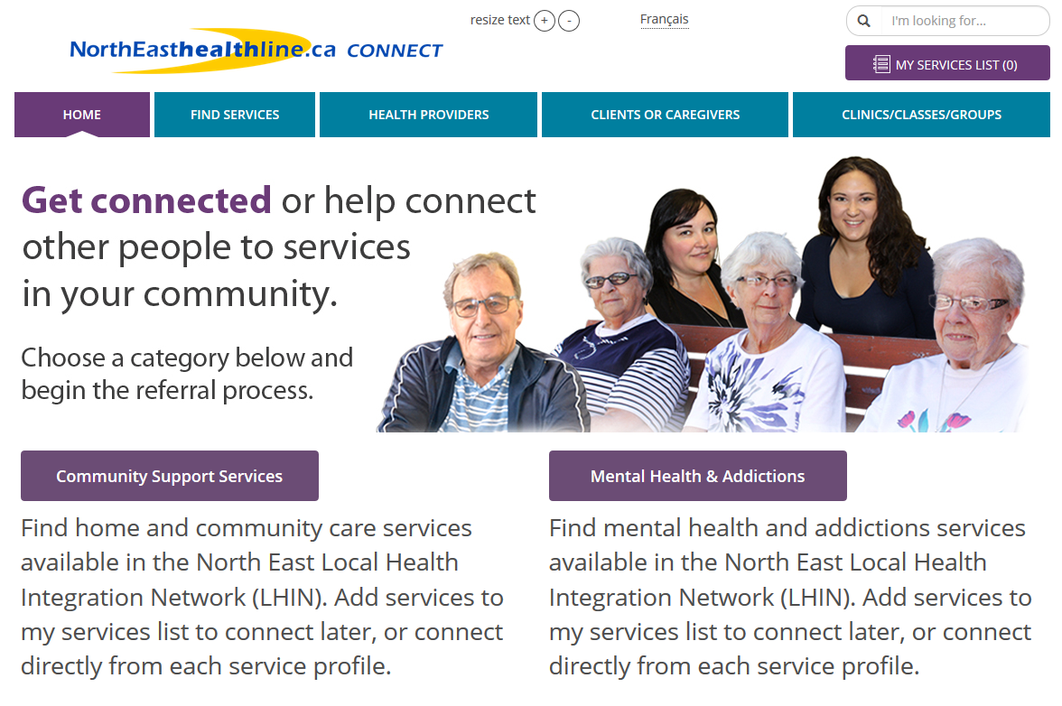
Using the Web

Slide 6
Using  Referral

Slide 7

Why?
From the perspective of the referring source…
48 LHIN-funded MH&A providers
Difficult to keep tabs on all of the services and eligibility criteria
Facilitates access and transitions for referring providers and clients

Slide 8

Why?
From the perspective of MH&A organizations receiving referrals …
Majority are small organizations
Intake person sometimes also service provider
Referrals from provider and public
Referrals from 5 different pathways
Phone, fax, email, drop by visits

Slide 9
Any of this sounding familiar?
Let’s take a quick step back to October 2015
Launch of www.northeastcss.ca
Single authoritative source of information on the web for Home and Community Care (CSS)
Still going strong and will continue!
NEW site will include Home and Community Care (CSS) and MH&A – simply rolled up into one website.
Anyone clicking on www.northeastcss.ca will simply be automatically redirected to connect.northeasthealthline.ca

Slide 10
MH&A Common Referral Form…

Slide 11
Must-Haves for Common Referral
Privacy and security requirements
User friendly for clients
Standardized pick-lists to help clients and providers find services
Ease of use for referrers and providers
Quick connection to services

Slide 12

Striking a Perfect Balance…
Collecting ‘just enough information’ to start the conversation between clients and the right providers
Too much information…
  Not user-friendly
  Won’t be completed
  Impossible to incorporate every data element required by every service
Too little information…
  Delays access
  Clients sent in ‘wrong’ direction
  Privacy impacts
Referral form…not Intake or Assessment
A form…not a process

Slide 13
Using the Common Referral Form

Slide 14
Making a Referral to MH&A
3 simple steps
Complete/print the Common Referral Form
Print the Referral Contact Information Form
Fax both forms to selected MH&A service

Slide 15
MH&A Common Referral Form
‘fillable PDF’
Enter patient/client information into the form
Print the filled form

Slide 16
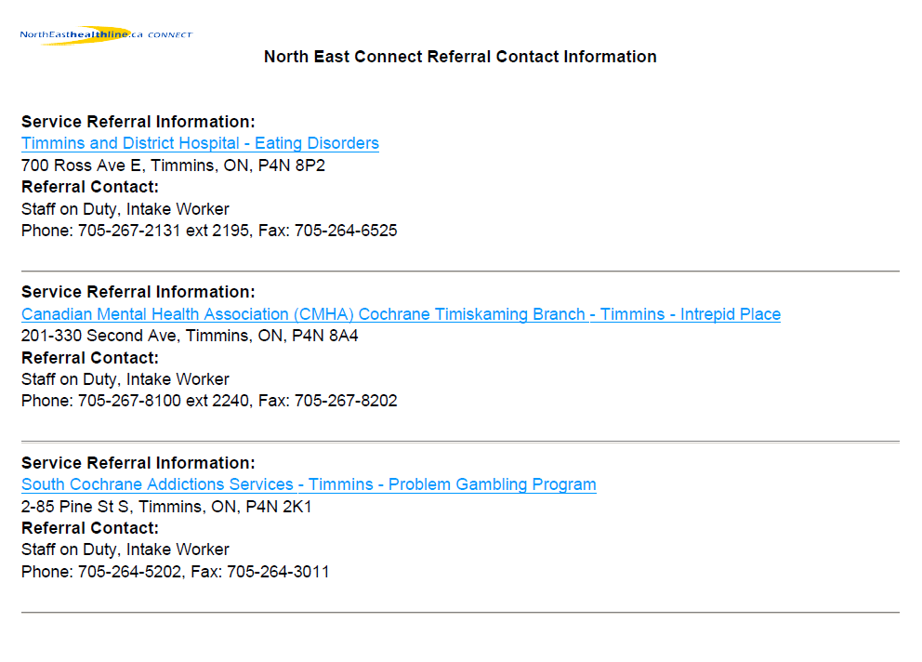
Referral Contact Information Form
LB

Slide 17
Fax BOTH forms to selected service

Slide 18
Receiving a Referral

Slide 19
Common Referral Form
Common referral form should already contain
  Patient/client information
  Pertinent referral information

Slide 20
What shouldn’t change…
Communication back to referring HSP and client about:
    Eligibility
    Intake
    Wait lists / times
    Service status
KEY MESSAGES
Common Referral Form is a tool
Used by choice and is not mandatory
We encourage all providers to be prepared to accept the Common Referral Form
All other process should not change
Intake (assessment / eligibility review) will still be required

Slide 21
General Public Requests for Information or Self-Referral

Slide 22
Using the web…
Connect.NorthEasthealthline.ca

Slide 23
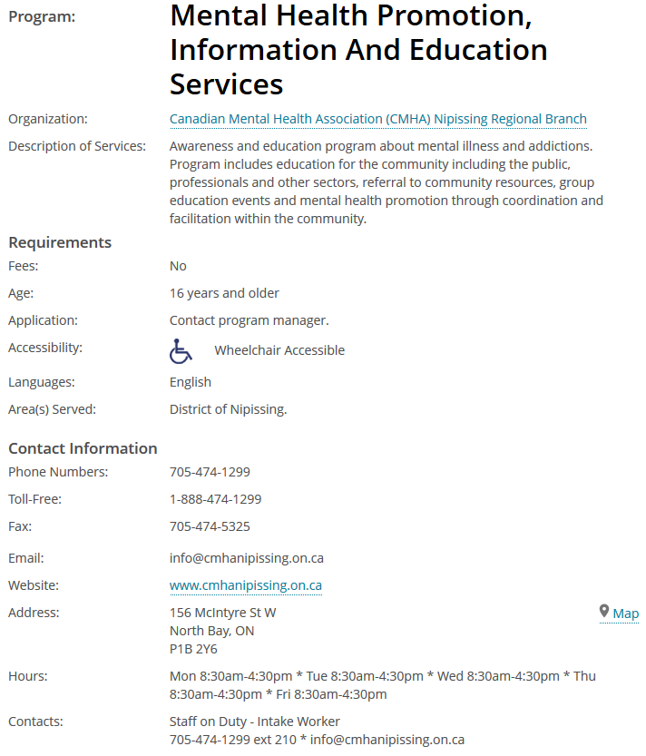
Service profiles
Information to determine if a service is going to meet a need
Includes details like:
Service description, fees, application process, accessibility information, available languages, contact info, hours of operation
~1000 LHIN-funded CSS and MH&A services available on NorthEasthealthline.ca Connect
Easy tools to connect people to information and facilitate referrals

Slide 24
Service profiles are accurate and up-to-date
Each service profile is updated annually
Tools for providers to submit updates 24/7
MH&A data managed by ConnexOntario, CSS data managed by North East CCAC
Data standards help make information easy to find and understand
CSS data standards applied by North East CCAC, MH&A data standards applied by North East MH&A service providers

Slide 25
MH&A Data Standards
Download at datastandards.northeasthealthline.ca
Currently a last call working draft, living breathing document
Developed using:
  MOHLTC Functional Centre descriptions
  Existing service profiles
  Literature reviews
  Feedback from subject-matter experts
Questions about using MH&A data standards to update your data? Contact UserSupport@thehealthline.ca

Slide 26

North East CCAC
2590+ service profiles for health and social services in North East LHIN
ConnexOntario
560+ MH&A services profiles imported weekly (started Jan 2016)
650+ services profiles that serve North East LHIN from other health regions
Data sources
Data projects
Provincial Services Directory
Where service profiles are translated and categorized
Connect.NorthEasthealthline.ca
NorthEasthealthline.ca
Organized into
350+ categories
including 50+ MH&A categories
Other sites for target audiences or with specialized referral tools
Behavioural Supports Ontario
caregiverexchange.ca

Slide 27
Let’s Take A Look…
Demonstration: Connect.NorthEasthealthline.ca

Slide 28
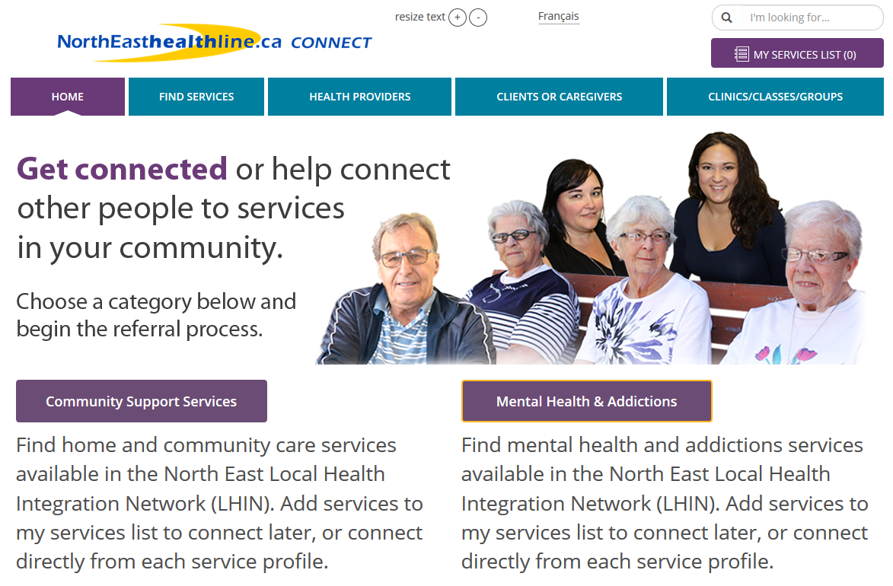
Visit Connect.NorthEasthealthline.ca
Note: northeastcss.ca will link directly to CSS page

Slide 29
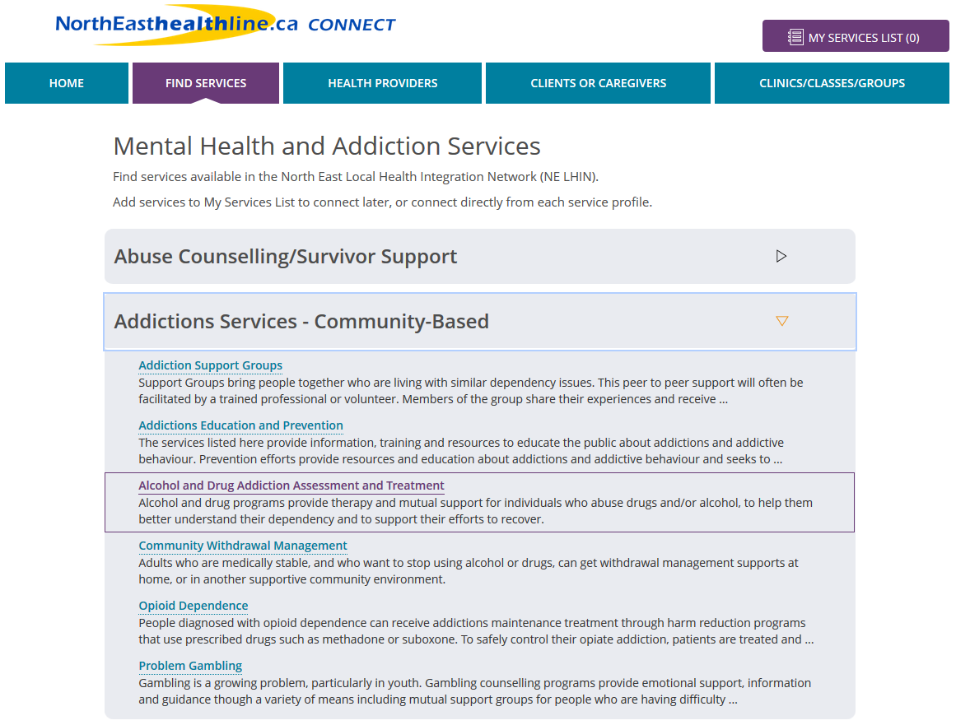
Click a category to find services by type

Slide 30
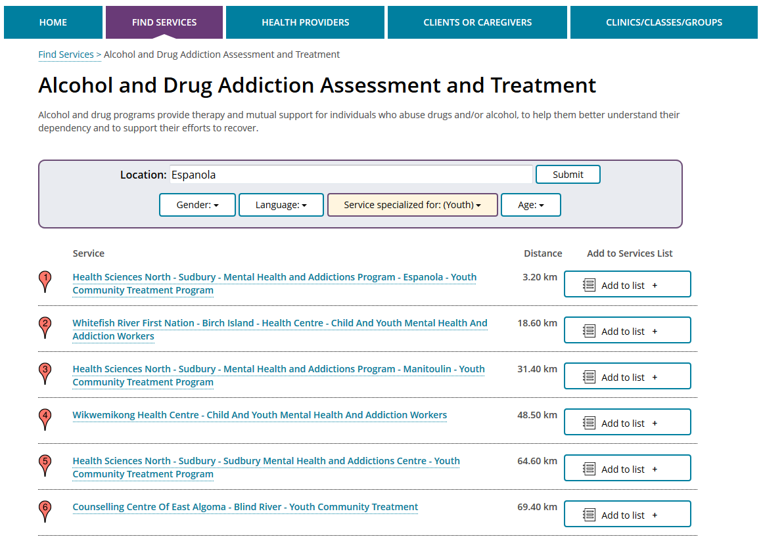
Filter services by location and details

Slide 31
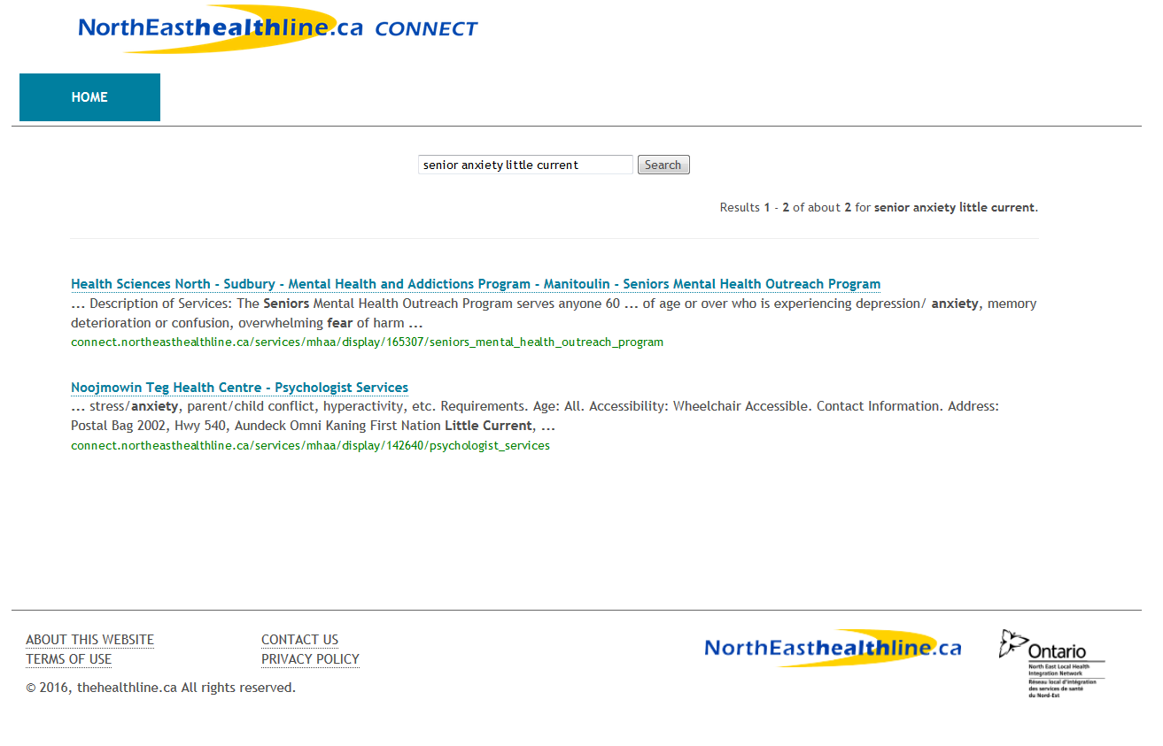
Use the search to find services by keyword

Slide 32
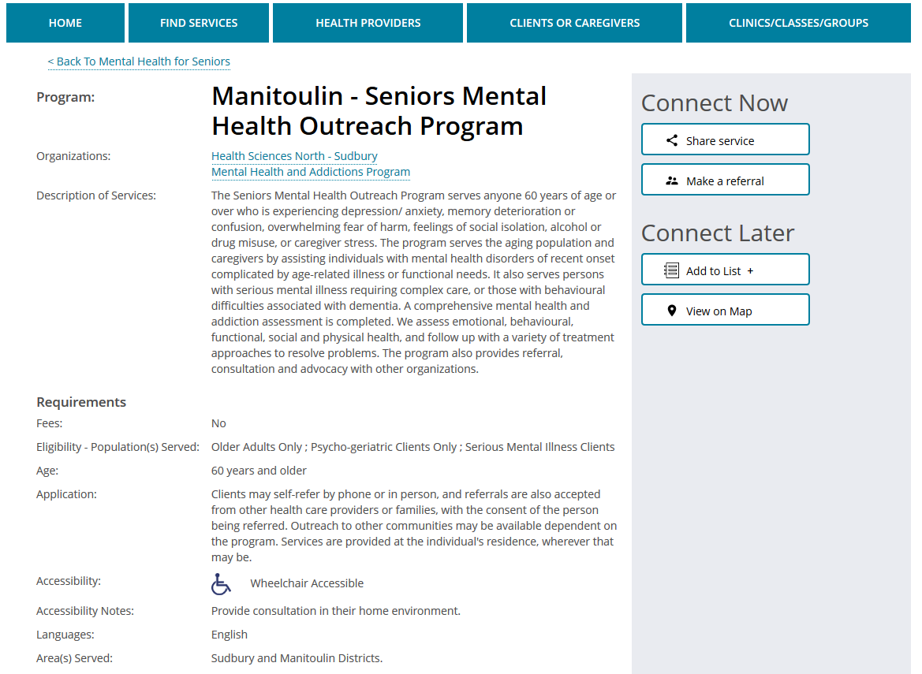
Connect now, or connect later via your list

Slide 33
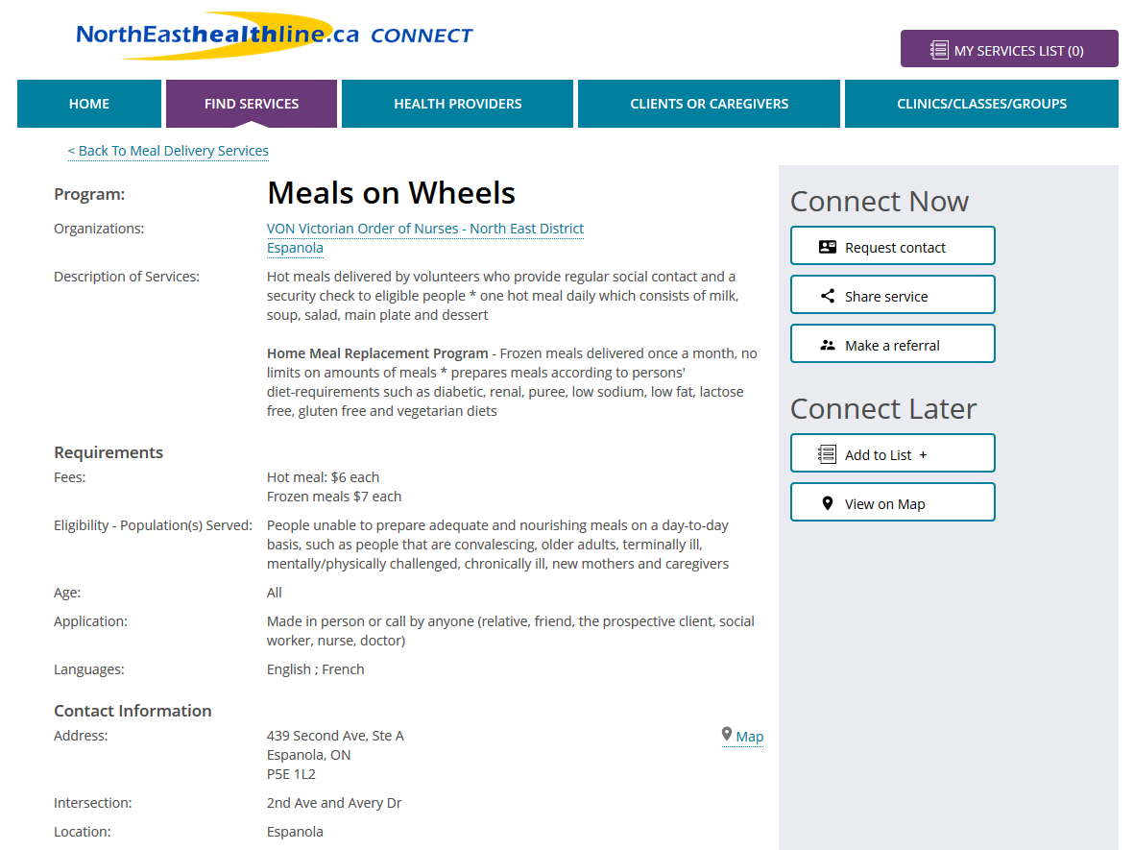
Can also ‘Request contact’ from CSS profiles

Slide 34
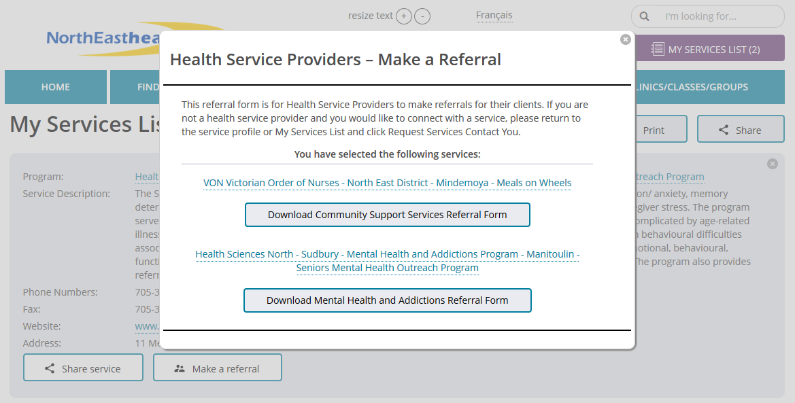
Connect to CSS + MH&A services via the list

Slide 35
Support and Reference Materials

Slide 36
Support Available
Refer to posted and distributed training reference materials
  Connect.Northeasthealthline.ca
  >> Health Care Providers tab
  – click on tab for ‘drop down’ list
  Reference Materials
    PowerPoint slides of this presentation with screen shots (in place of LIVE demonstration)
    Quick Reference Guide
    Reminder/Refresher Flyer to share with healthcare providers within your organization and with those referring to you
Consult with peers, managers and/or referral working group members in your organization
- send email for assistance

Slide 37
Privacy Refresher

Slide 38
Privacy and Security
Please be mindful of your privacy and security responsibilities
No personal health information is kept on Connect.Northeasthealthline.ca
Review the 4 “Privacy Refresher” slides posted at:
  Connect.Northeasthealthline.ca
  >> Health Care Providers tab – click on tab for ‘drop down’ list
  >> Reference Materials

Slide 39
Privacy - CSA Model Code
CSA model code for the protection of personal information
10 principles based on the Canadian Standards Association’s Model Code for the Protection of Personal Information
Recognized as a national standard
Addresses how organizations collect, use, and disclose personal information
Rights of individuals to have access to their personal information and to have it corrected if necessary

Slide 40
Privacy and Personal Information Responsibilities
1: Accountability
An organization is responsible for PHI under its control and shall designate an individual who is accountable for the organization’s compliance with the following principles.
2: Identifying Purposes
The purposes for which PHI is collected shall be identified by the organization at or before the time the information is collected.
3: Consent
The knowledge and consent of the individual are required for the collection, use or disclosure of PHI, except when inappropriate.

Slide 41
Privacy and Personal Information Responsibilities
4: Limiting Collection
The collection of PHI shall be limited to that which is necessary for the purposes identified by the organization. Information shall be collected by fair and lawful means.
5: Limiting Use, Disclosure and Retention
PHI shall not be used or disclosed for purposes other than those for which it was collected, except with the consent of the individual or as required by the law. PHI shall be retained only as long as necessary for fulfillment of those purposes.

Slide 42
Privacy and Personal Information Responsibilities
6: Accuracy
PHI shall be as accurate, complete and up-to-date as is necessary for the purposes for which it is to be used.
7: Safeguards
PHI shall be protected by security safeguards appropriate to the sensitivity of the information.
8: Openness
An organization shall make readily available to individuals specific information about its policies and practices relating to the management of PHI.

Slide 43
Privacy and Personal Information Responsibilities
9: Individual Access
Upon request, an individual shall be informed of the existence, use and disclosure of his or her personal information and shall be given access to that information. An individual shall be able to challenge the accuracy and completeness of the information and have it amended as appropriate.
10: Challenging Compliance
An individual shall be able to address a challenge concerning compliance with the above principles to the designated individual or individuals for the organization’s compliance.

Slide 44
Questions?
Questions about Mental Health and Addictions Data Standards?
Download at: datastandards.northeasthealthline.ca
Questions to: usersupport@thehealthline.ca
Questions about the MH&A referral form and Connect.NorthEasthealthline.ca project?
Jennifer Michaud, Jennifer.Michaud@LHINS.ON.CA
Questions about how to use Connect.NorthEasthealhtline.ca?
Connect@NorthEasthealthline.ca

