Slide 1
Referral to
Community Support Services
August 2015
For posting

Slide 2
Agenda
Background
Referral Process
North East Community Support Services mini-site (NE CSS mini-site)
Sending a Referral
Receiving a Referral
Responding to Request from General Public
Support and Reference Materials
Changes and Improvements
Privacy Refresher
Questions
New Common Referral Form

Slide 3
Background

Slide 4
Why are we changing?
Spring 2014, NE LHIN identified a need to streamline referrals to over 60 CSS organizations in 5 referral pathways
  Acute Care to CSS
  Primary Care to CSS
  Community Care Access Centres (CCAC) to CSS
  CSS to CSS
  Mental Health and Addictions services to CSS

Slide 5
How did we get here?
Working Groups – Reps from 5 referral pathways
CSS System Navigators
CSS Regional Network
Identified Referral Information Needs
Developed common standardized form
Developed new process with use of NE CSS mini-site

Slide 6
Working Group Recommendations
One referral form to CSS from all pathways
Coordinated Access
Integrated assessment record
Consistent communication to the referring HSP and client, when requested:
Patient/client eligible and either wait listed or service arranged
Patient/client has received the service, or service has been initiated
Authoritative list of CSS services and their location (Healthline)

Slide 7
When are we going to change?
May 27 | Use of the new referral form, process and NE CSS mini-site by CSS HSP referring to CSS organizations
Spring/Summer | Use of the form, process and CSS mini-site by HSPs from all other pathways referring to CSS organizations
Summer | Formal launch with media release and promotion of CSS mini-site for the general public to request information and/or self-refer to a CSS organization or to share the information with a friend (by email).

Slide 8
Overview of Change
CSS HSPs
Sending referrals to other CSS
Receiving referrals from the other 4 pathways (Acute, Primary, CCAC, MH&A)
Responding to requests for information or self-referral (where appropriate) from the general public (via NE CSS mini-site)
‘Other Pathways’ HSPs
Sending referrals to CSS

Slide 9
Referral Process
1. Identify client needs
2. Obtain consent to refer
Access North East CSS mini-site
3. Go to Access North East CSS mini-site:
- identify services available
- identify CSS agencies
- review eligibility criteria
- review other relevant info
4. Determine which agency(s) should receive referral
Call 310-2222 or 310-2272
North East CSS mini-site is used as the single, authoritative source of information on the CSS sector.
Complex referral (out of scope)
END
5. Download common referral form from HL
6. Electronically complete common referral form
7. Send common referral form to CSS agency(s)
8. Receive referral
9. Initial review
10.Initiate intake
Common referral form should already contain client demographic information and pertinent referral information. Time freed up for intake activities, assessments, etc.

Slide 10
Referral Process
15. Arrange/document service appt details
11. Client eligible?
14. Contact client to (1) book services OR (2) place on wait list
17. If required, notify Referring HSP that (1) client’s services booked or (2) client wait listed
Yes
No
16. Place client on wait list
12. Inform Referring HSP that client not eligible
13. Inform client that they are not eligible
END
Communication back to Referring HSP and client occurs consistently:
- whether client is eligible
- when service is arranged or client placed on wait list
- when service has been initiated or completed

Slide 11
Referral Process continued
18. Provide service
19. Document service initiated/provided
20. if required, notify Referring HSP of service status
END
CSS HSP workflow (out of scope)

Slide 12
Common Form for Referral to CSS

Slide 13
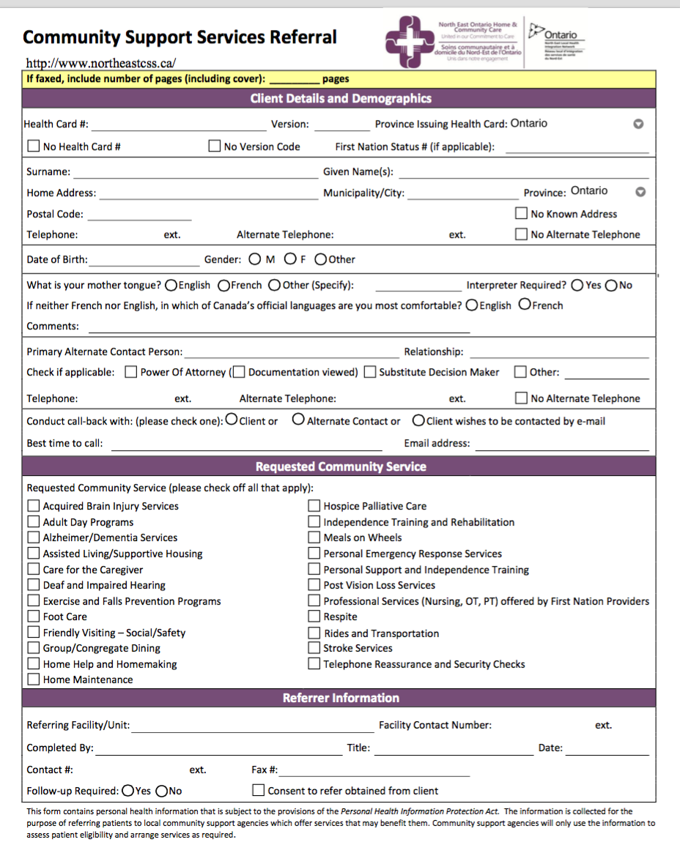
English language form displayed here
French language form is also available

Slide 14
NE CSS mini-site

Slide 15
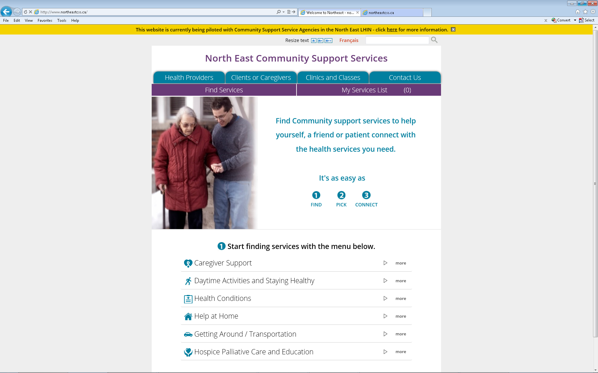
NE CSS Mini-site
Single authoritative source of information about the CSS Sector

Slide 16
NE CSS mini-site
HSP referring a patient/client for CSS can pick from a list of CSS organizations based on a location or patient/client address
NE CSS mini-site is available to the general public to request information from CSS organizations and to self–refer for services (where appropriate).
NE CSS mini-site supports HSPs and the general public with information
What services are available from which organizations and where?
Description of the service
Requirements of the services
Contact information for the service

Slide 17
Sending a Referral

Slide 18
Sending a Referral
Identify patient/client needs
Confirm client’s consent to refer and share patient/client information
Access NE CSS mini-site
Enter patient/client location
Find services
View service organization’s information
Select service(s)
Download, complete and print the CSS Referral Form
Print the Referral Contact Information Form
Fax both forms to the service selected

Slide 19
Sending a Referral
Access NE CSS mini-site
www.northeastcss.ca (English)
www.sscnordest.ca (French)

Slide 20
Sending a Referral
Find Services
Start : Select service category

Slide 21
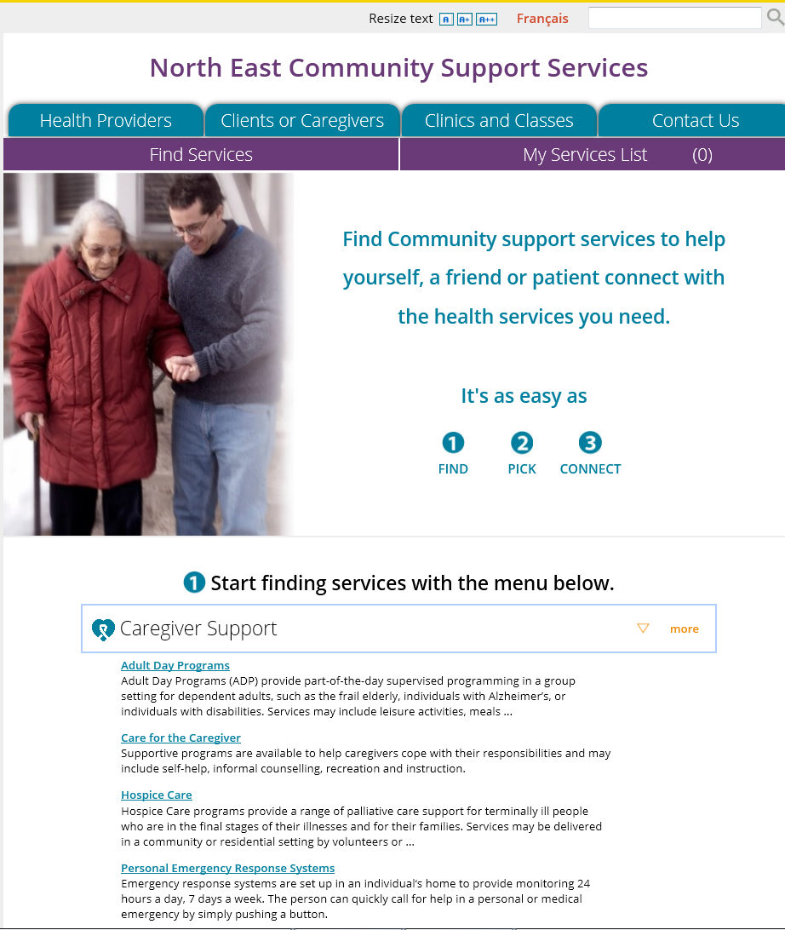
Sending a Referral
Find Services
View service sub-category listing - Select service sub-category

Slide 22
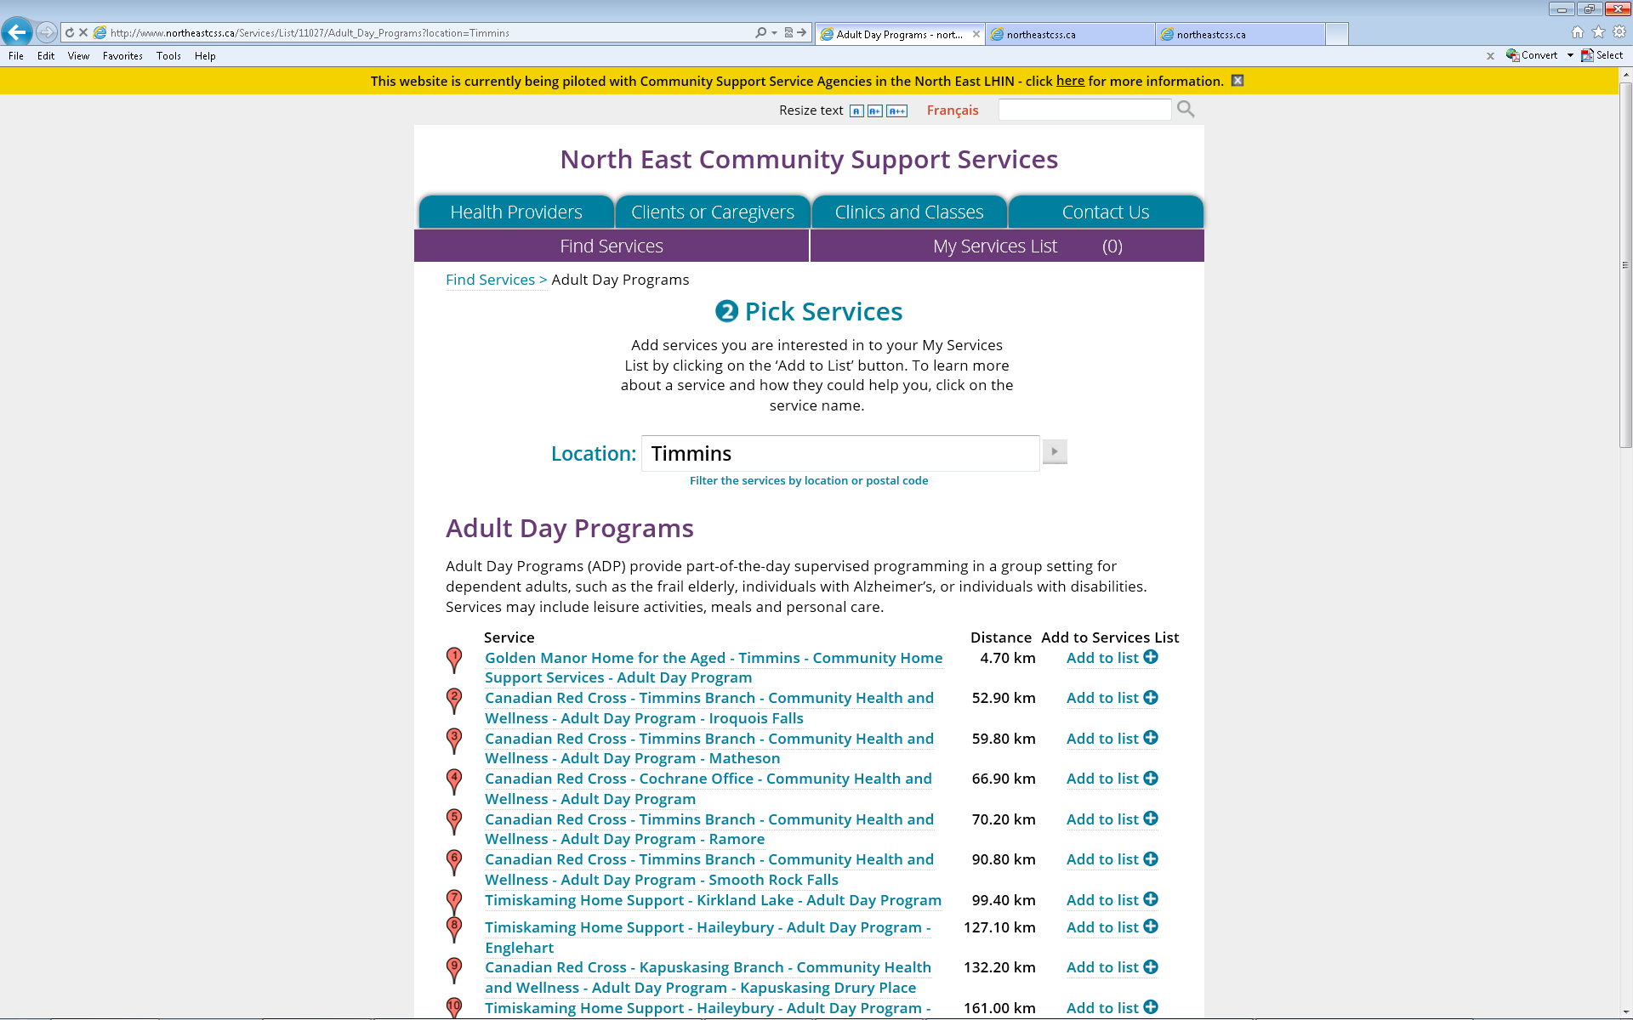
Sending a Referral
1 Find Service
View list of organizations providing service required (enter location or postal code to filter list) and select desired Health Service Provider

Slide 23
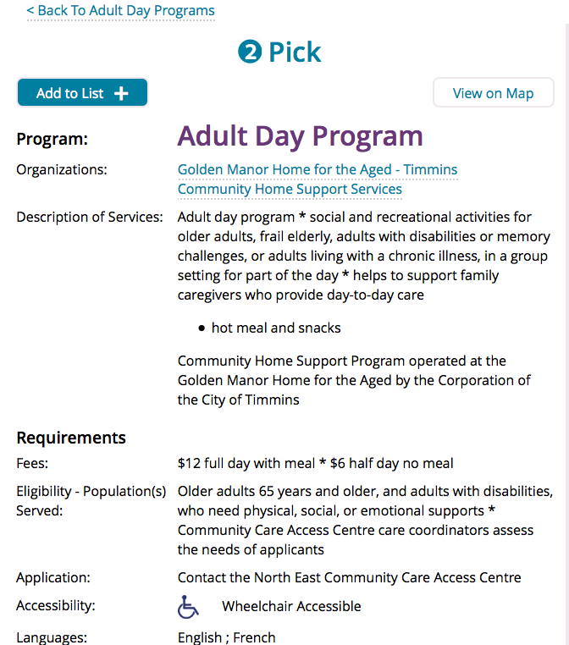
Sending a Referral
View selected organizational information

Slide 24
Sending a Referral
2 Pick
“Pick” the organization – it will be added to a list of services selected

Slide 25
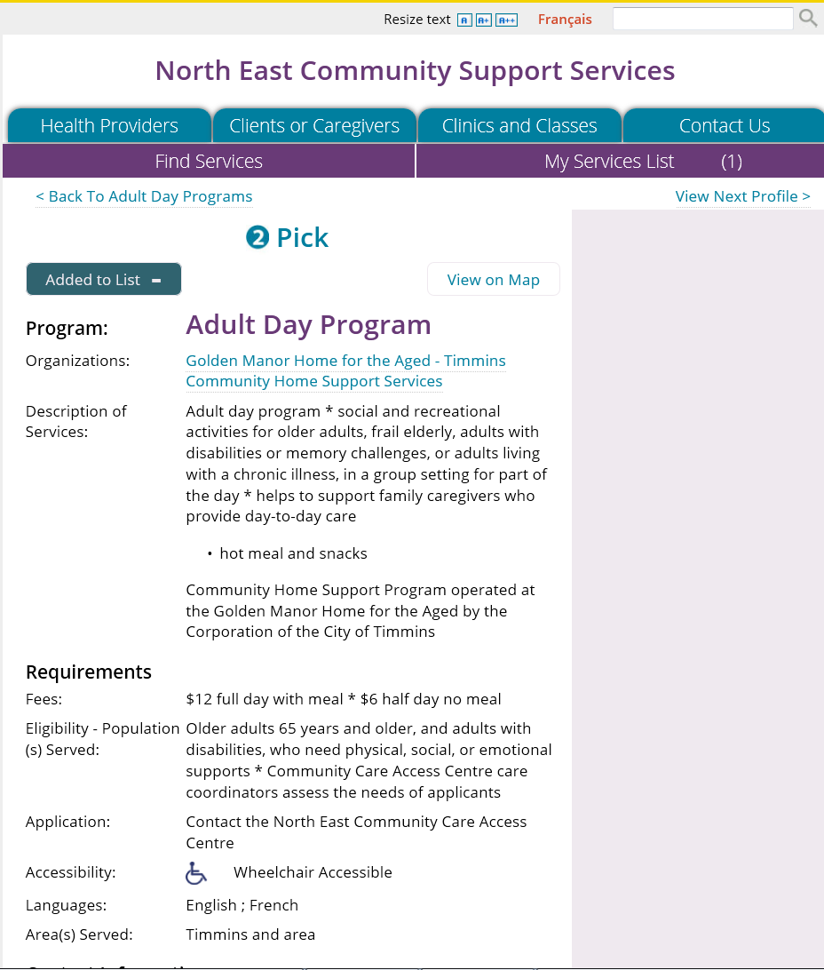
Sending a Referral
2 Pick
The organization is now added to ‘My Services’ List

Slide 26
Sending a Referral
Want to refer to another service?
Go back to Find Services
2 Pick - selecting 2nd service for referral

Slide 27
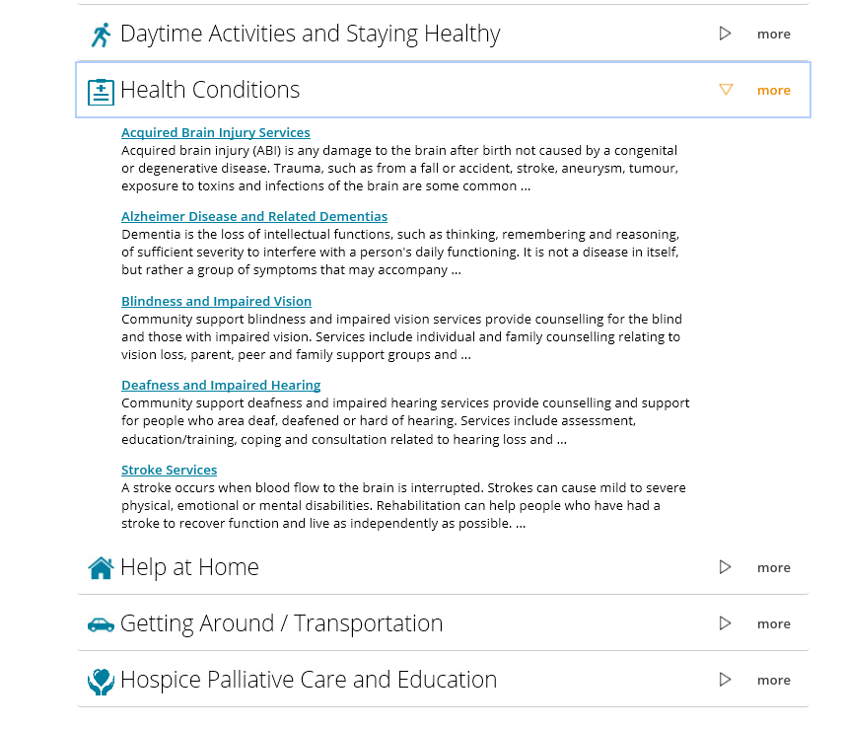
Sending a Referral
2 Pick - selecting 2nd service for referral

Slide 28
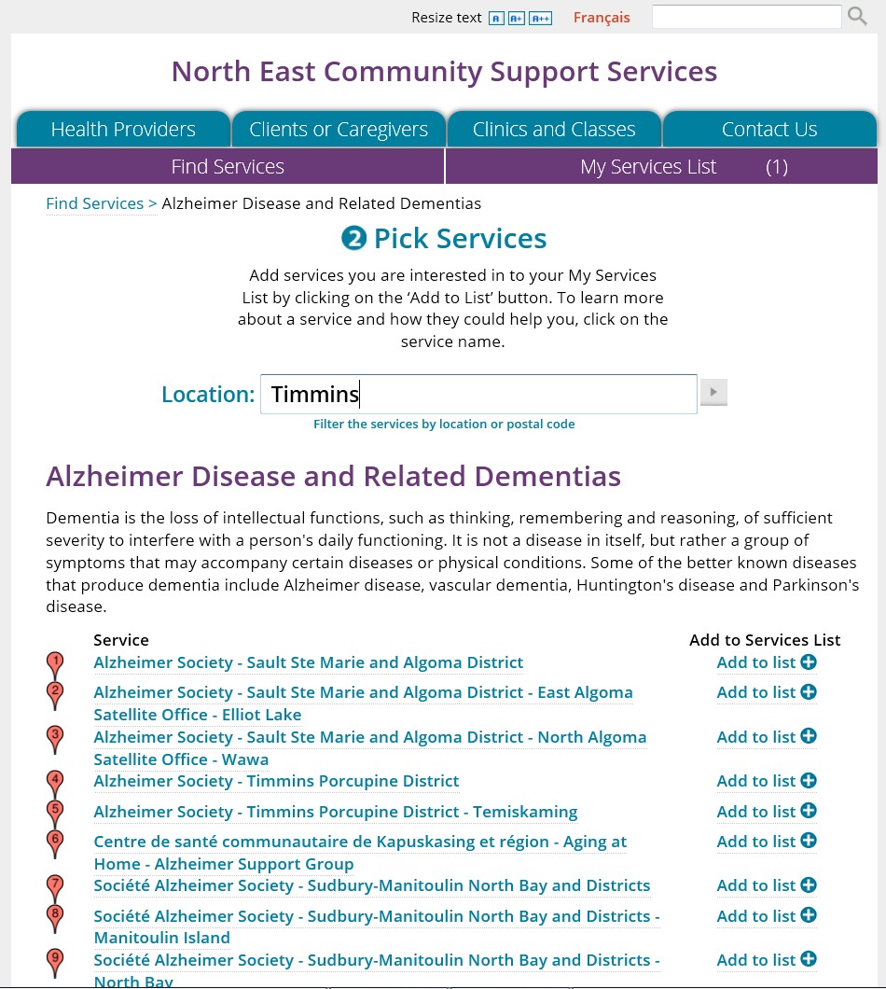
Sending a Referral
2 Pick - selecting 2nd service for referral

Slide 29
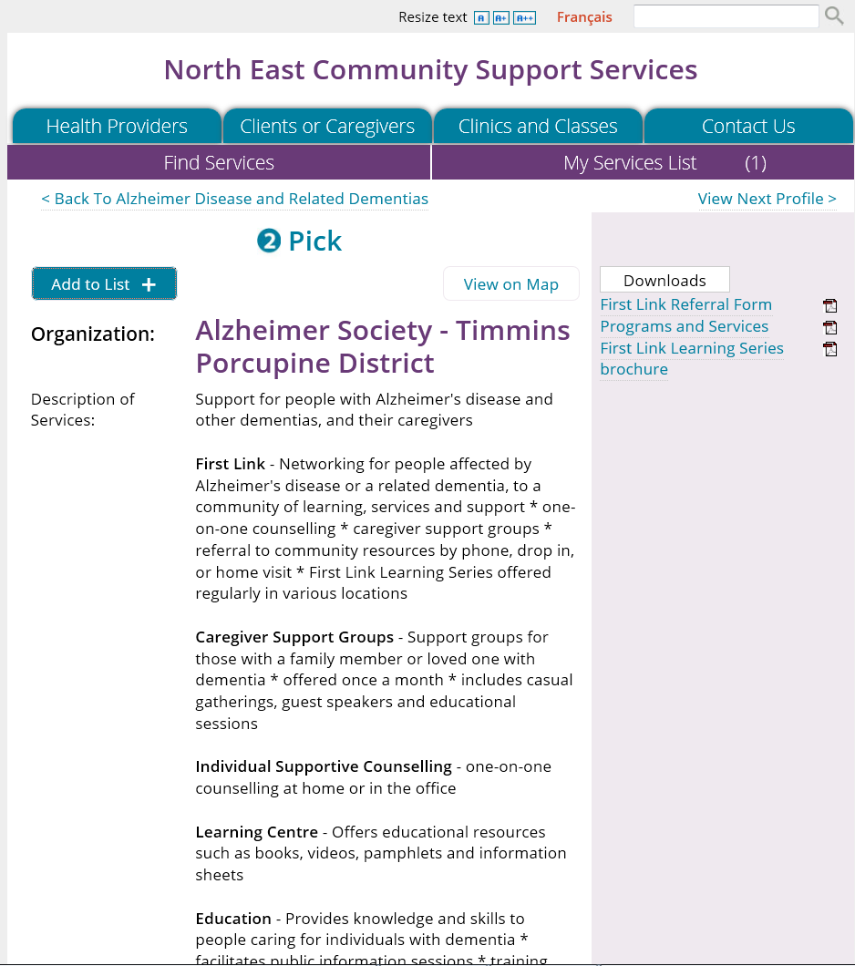
Sending a Referral
View information about organization

Slide 30
Sending a Referral
2 Pick - 2nd service for referral added to “My Services”

Slide 31
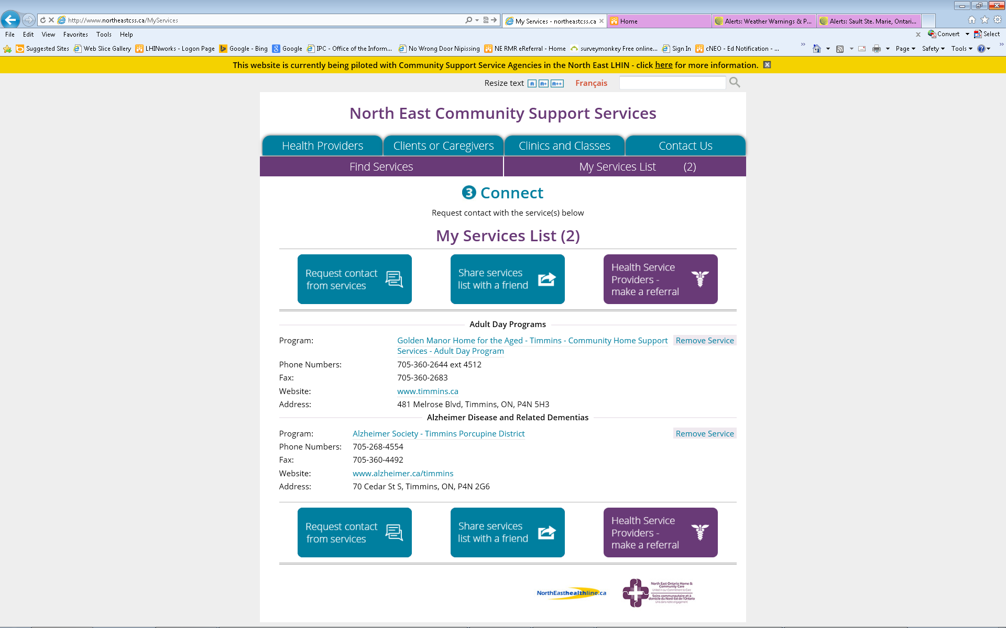
Sending a Referral
3 Connect
Select ‘My Services List’
Note: 2 services in header
Select ‘Health service Provider – Make a Referral’
Note: Remove service button is available

Slide 32
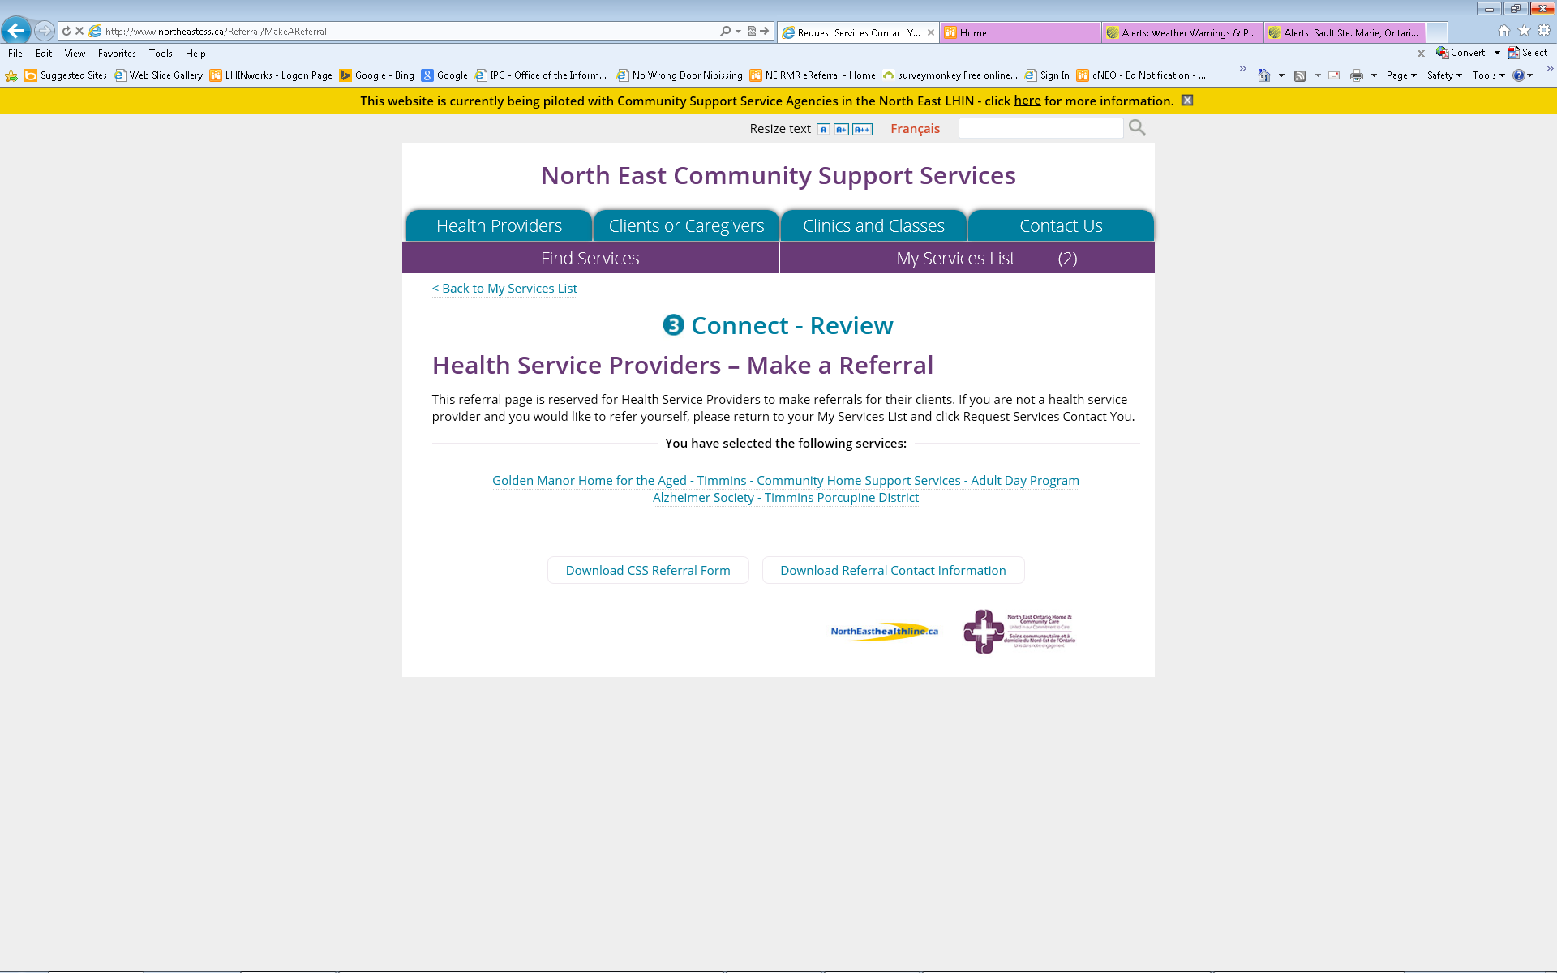
Sending a Referral

Slide 33
Sending a Referral
Connect – Review page
Click on download CSS Referral Form AND Download Referral Contact Information

Slide 34
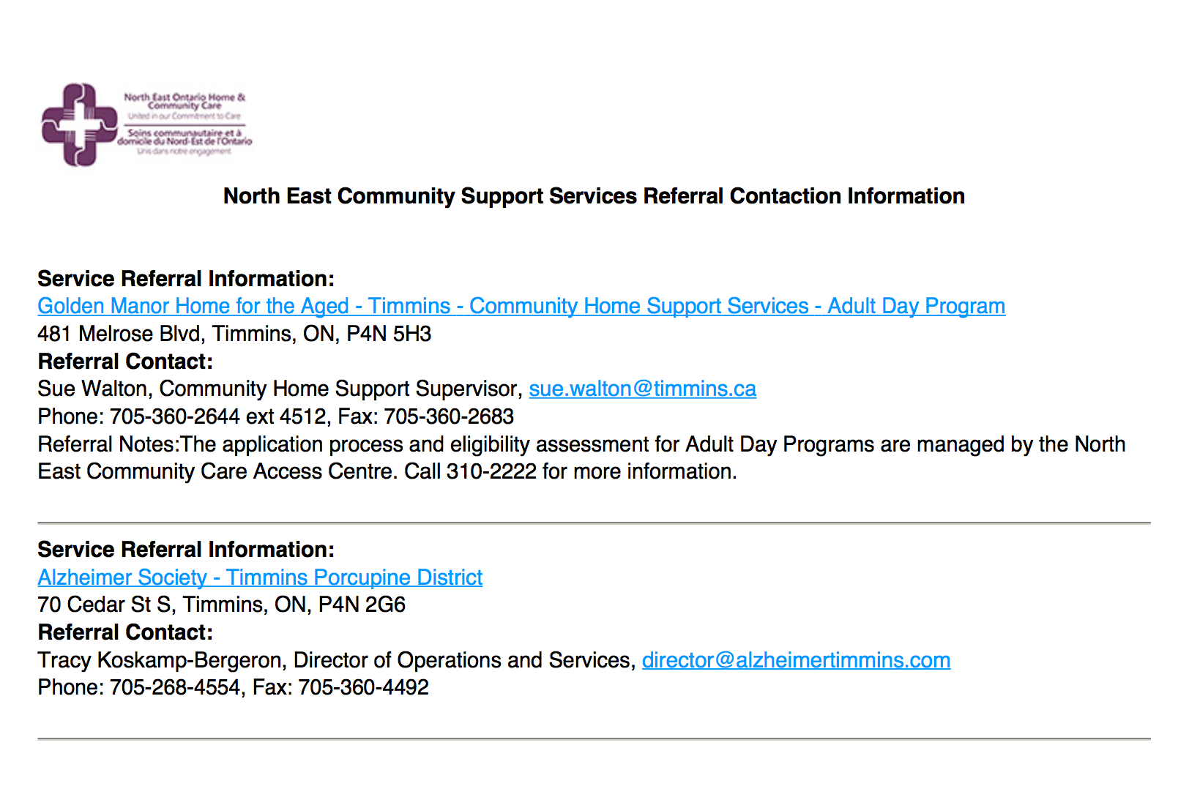
Sending a Referral
3 Connect – Review page
Print the Referral Contact Information Form

Slide 35
Sending a Referral
3 Connect – Review page
CSS Referral Form is a ‘fillable PDF’ where you can enter patient/client information
Enter patient/client information into the form
Print the filled form

Slide 36
Sending a Referral
Fax BOTH forms

Slide 37
Sending a Referral
Identify patient/client needs
Confirm client’s consent to refer and share patient/client information
Access NE CSS mini-site
Enter patient/client location
Find services
View service organization’s information
Select service(s)
Download, complete and print the CSS Referral Form
Print the Referral Contact Information Form
Fax both forms to the service selected

Slide 38
Receiving a Referral

Slide 39
Common Referral Form
Common referral form should already contain
  Patient/client information
  Pertinent referral information.

Slide 40
Communication Points
Communication back to Referring HSP and patient/client occurs consistently at the following points
Whether patient/client is eligible
When service is arranged or patient/client is placed on wait list
When service has been initiated

Slide 41
Receiving a Referral
Do initial review of information
Is the referral complex?
If no, Receiver initiates intake process
Is patient/client eligible?
If no, Receiver informs Referring HSP that patient/client is not eligible via fax or letter
Receiver informs patient/client by phone or letter
Patient/client is eligible
Contact patient/client to book services or place on wait list
If yes, Receiver will contact referring HSP and discuss and consult with others as needed

Slide 42
Receiving a Referral
If requested on referral form, notify Referring HSP
If requested on referral from, notify Referring HSP
Patient/client services booked or
Patient/client on wait list
Provide services
Service status

Slide 43
Responding to General Public Requests for Information or Self-Referral

Slide 44
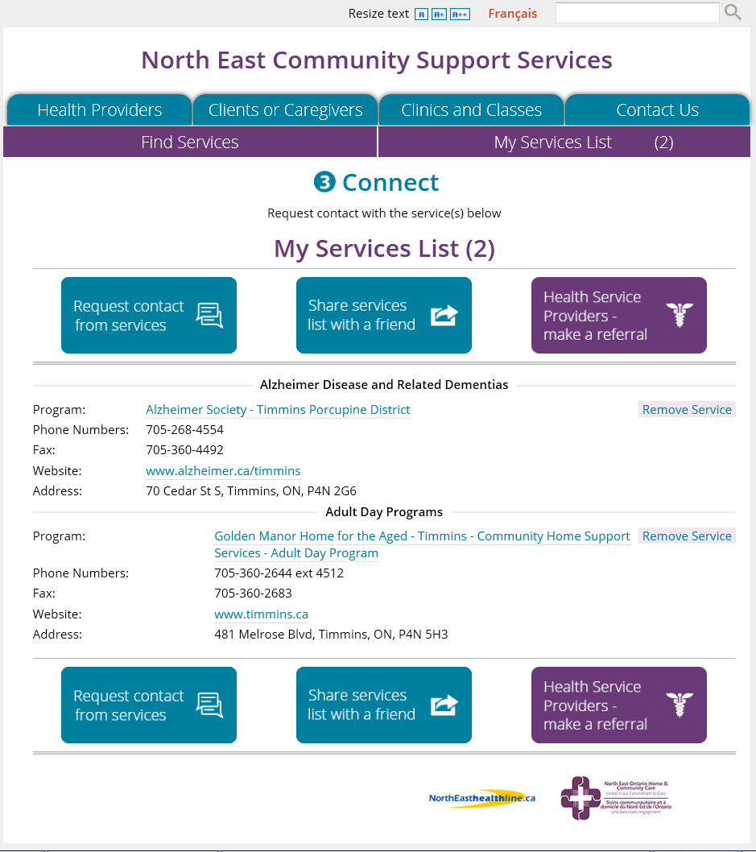
General Public
Follow the same process as HSPs to view available services by location
Build list of “My Services”
Then 2 options:
Request Services Contact You (telephone or email)
Share with a Friend (generates email)

Slide 45
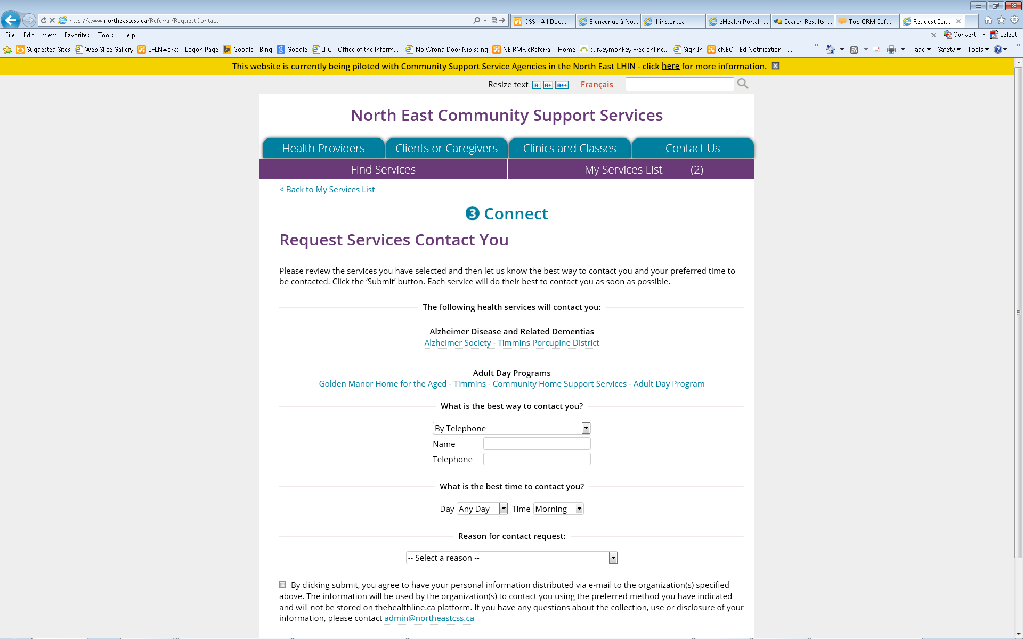
Request Contact
Individual completes asking for contact via
  Telephone or
  Email
Request generates an email message sent to your organization's designated contact

Slide 46
General Public – ‘Share with a Friend’
Follow the same process as HSPs to view available services by location
Build list of “My Services’
Select ‘Share with a Friend’

Slide 47
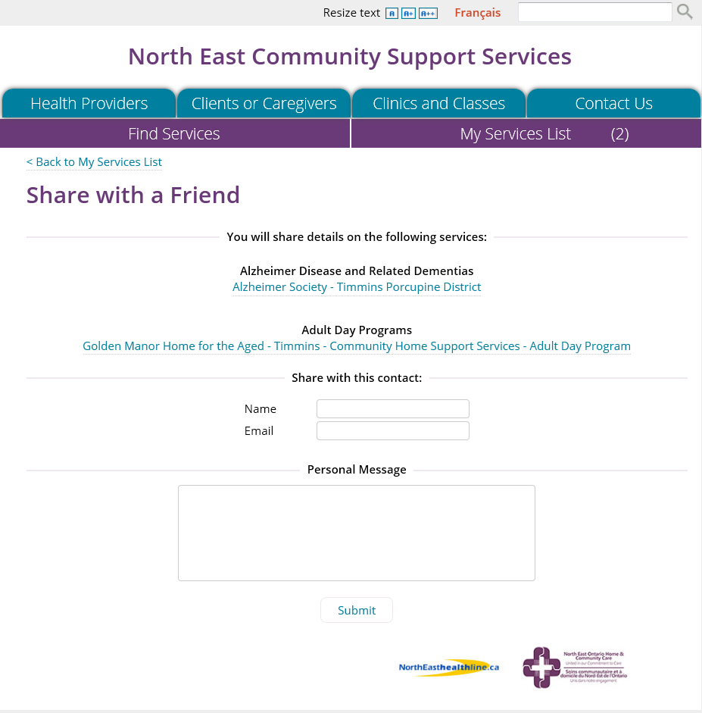
Share with a Friend
Individual completes form and submits
‘Friend’ receives information about the services provided by services in the ‘My Services’ List
A personal message can be included
Email contact is the only option – no telephone

Slide 48
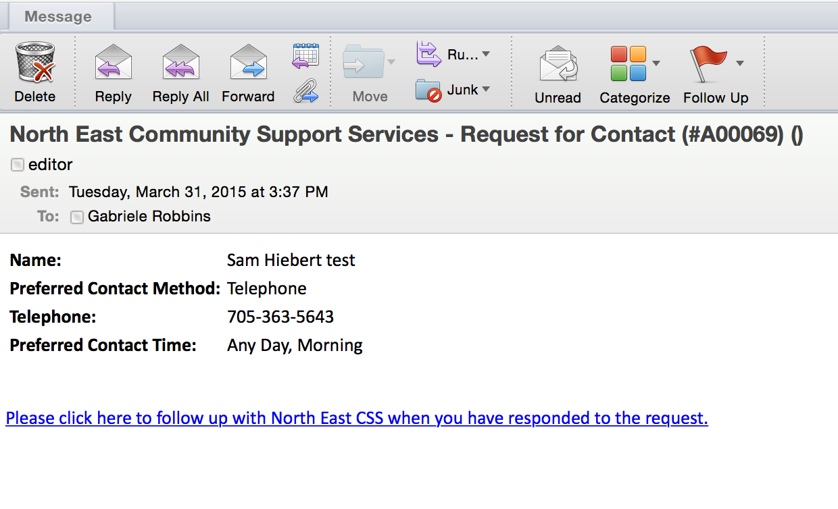
Receiving and responding to a request for information or self-referral
Respond and handle the request following your standard internal organizational process
Sample of email message that you will receive
Within the original email message that you receive, there is a link to use to report the outcome of the general public

Slide 49
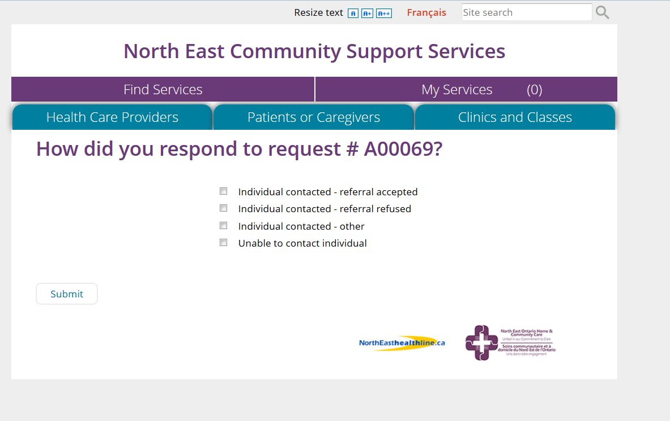
Responding to the request
When you click the link in the original email request, a screen opens asking you how you responded to the request. Please see below.

Slide 50
Support and Reference Materials

Slide 51
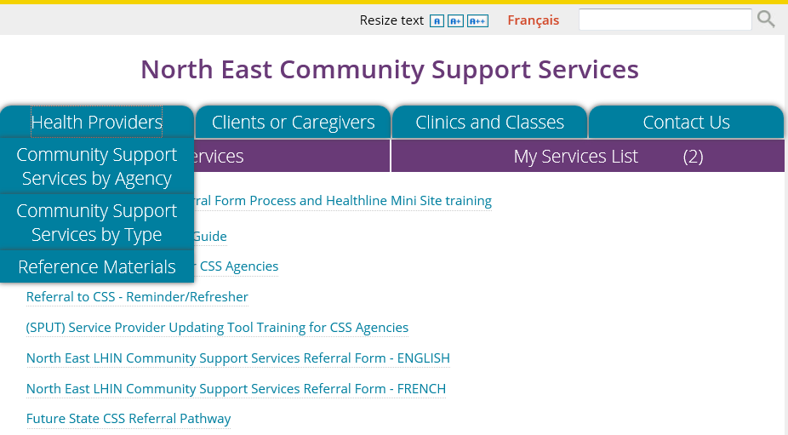
Support Available
Refer to posted and distributed training reference materials
  http://northeastcss.ca/
  >> Health Care Providers tab
  – click on tab for ‘drop down’ list
  Reference Materials
    VIDEO: North East CSS Referral Form Process and Healthline Mini Site training
    Referral to CSS - Quick Tips Guide
    Complete Training Guide for CSS Agencies
    Referral to CSS - Reminder/Refresher
    (SPUT) Service Provider Updating Tool Training for CSS Agencies
    North East LHIN Community Support Services Referral Form - ENGLISH
    North East LHIN Community Support Services Referral Form - FRENCH
    Future State CSS Referral Pathway

Slide 52
Support Available
Consult with peers, managers and CSS referral working group members in your organization
admin@northeastcss.ca - send email for assistance

Slide 53
Changes, Improvements and Optimization

Slide 54
Changes, Improvements and Optimization
As you use the form and process, improvements and new ideas will be identified
Please send your suggestions and ideas to admin@northeastcss.ca

Slide 55
Privacy Responsibilities
Refresher

Slide 56
Privacy and Security
Please be mindful of your privacy and security responsibilities
No personal health information is stored on the CSS mini-site.
Please review the 4 “Privacy Refresher” slides in the Training slide deck posted at:
  http://northeastcss.ca/
  >> Health Care Providers tab – click on tab for ‘drop down’ list
  >> Reference Materials

Slide 57
Privacy - CSA Model Code
CSA model code for the protection of personal information
10 principles based on the Canadian Standards Association’s Model Code for the Protection of Personal Information
Recognized as a national standard
Addresses how organizations collect, use, and disclose personal information
Rights of individuals to have access to their personal information and to have it corrected if necessary

Slide 58
Privacy Responsibilities
1: Accountability
An organization is responsible for personal information under its control and shall designate an individual or individuals who are accountable for the organization’s compliance with the following principles.
2: Identifying Purposes
The purposes for which personal information is collected shall be identified by the organization at or before the time the information is collected.
3: Consent
The knowledge and consent of the individual are required for the collection, use or disclosure of personal information, except when inappropriate.

Slide 59
Privacy Responsibilities
4: Limiting Collection
The collection of personal information shall be limited to that which is necessary for the purposes identified by the organization. Information shall be collected by fair and lawful means.
5: Limiting Use, Disclosure and Retention
Personal information shall not be used or disclosed for purposes other than those for which it was collected, except with the consent of the individual or as required by the law. Personal information shall be retained only as long as necessary for fulfillment of those purposes.

Slide 60
Privacy Responsibilities
6: Accuracy
Personal information shall be as accurate, complete and up-to-date as is necessary for the purposes for which it is to be used.
7: Safeguards
Personal information shall be protected by security safeguards appropriate to the sensitivity of the information.
8: Openness
An organization shall make readily available to individuals specific information about its policies and practices relating to the management of personal information.

Slide 61
Privacy Responsibilities
9: Individual Access
Upon request, an individual shall be informed of the existence, use and disclosure of his or her personal information and shall be given access to that information. An individual shall be able to challenge the accuracy and completeness of the information and have it amended as appropriate.
10: Challenging Compliance
An individual shall be able to address a challenge concerning compliance with the above principles to the designated individual or individuals for the organization’s compliance.

Slide 62
Questions

