Slide 1
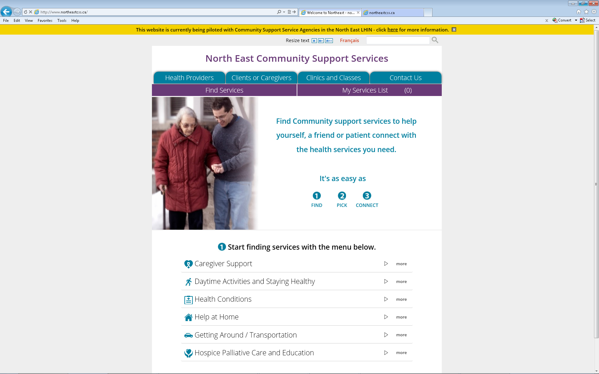
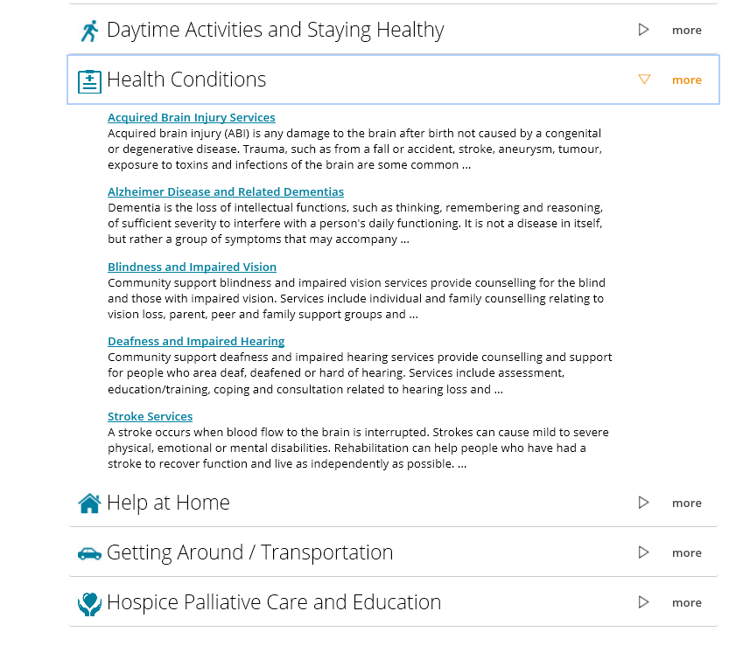
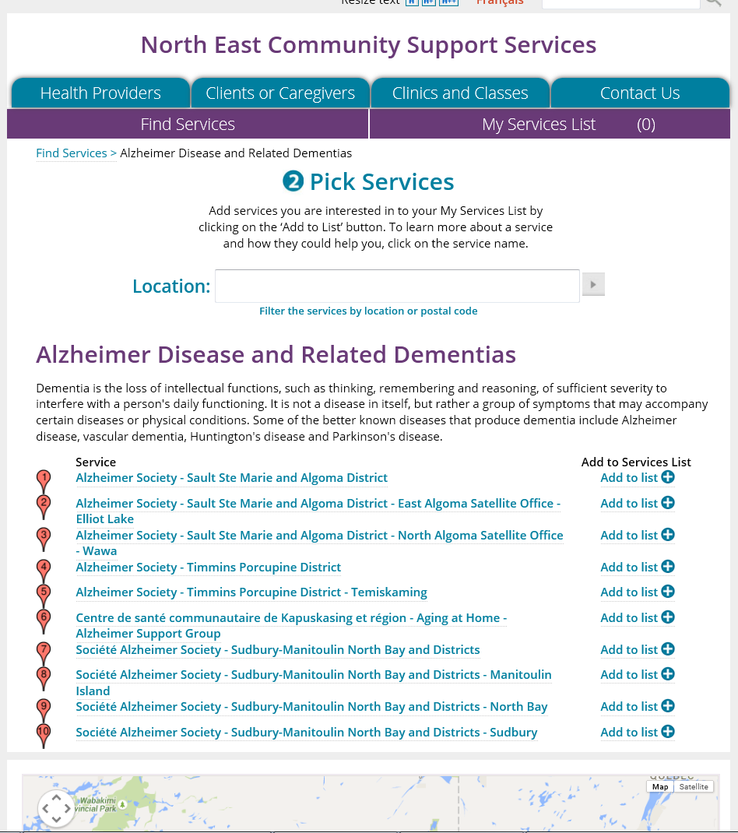
Referral to CSS – Quick Tip Sheet
Go to http://northeastcss.ca/
Find Services
  Start by selecting service categories
    example “Health Conditions”
  View service sub-category listing and select service sub-category (example Alzheimer Disease and Related Dementias)
  Enter location (or postal code) to filter services
  Select desired Health Service Provider

Slide 2
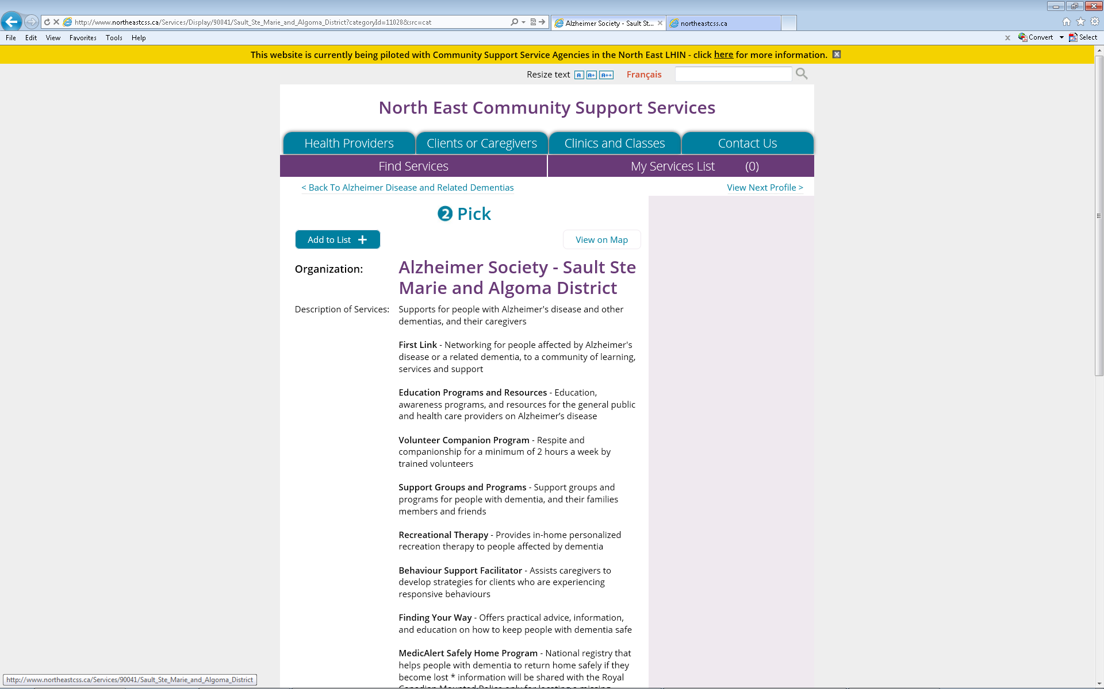
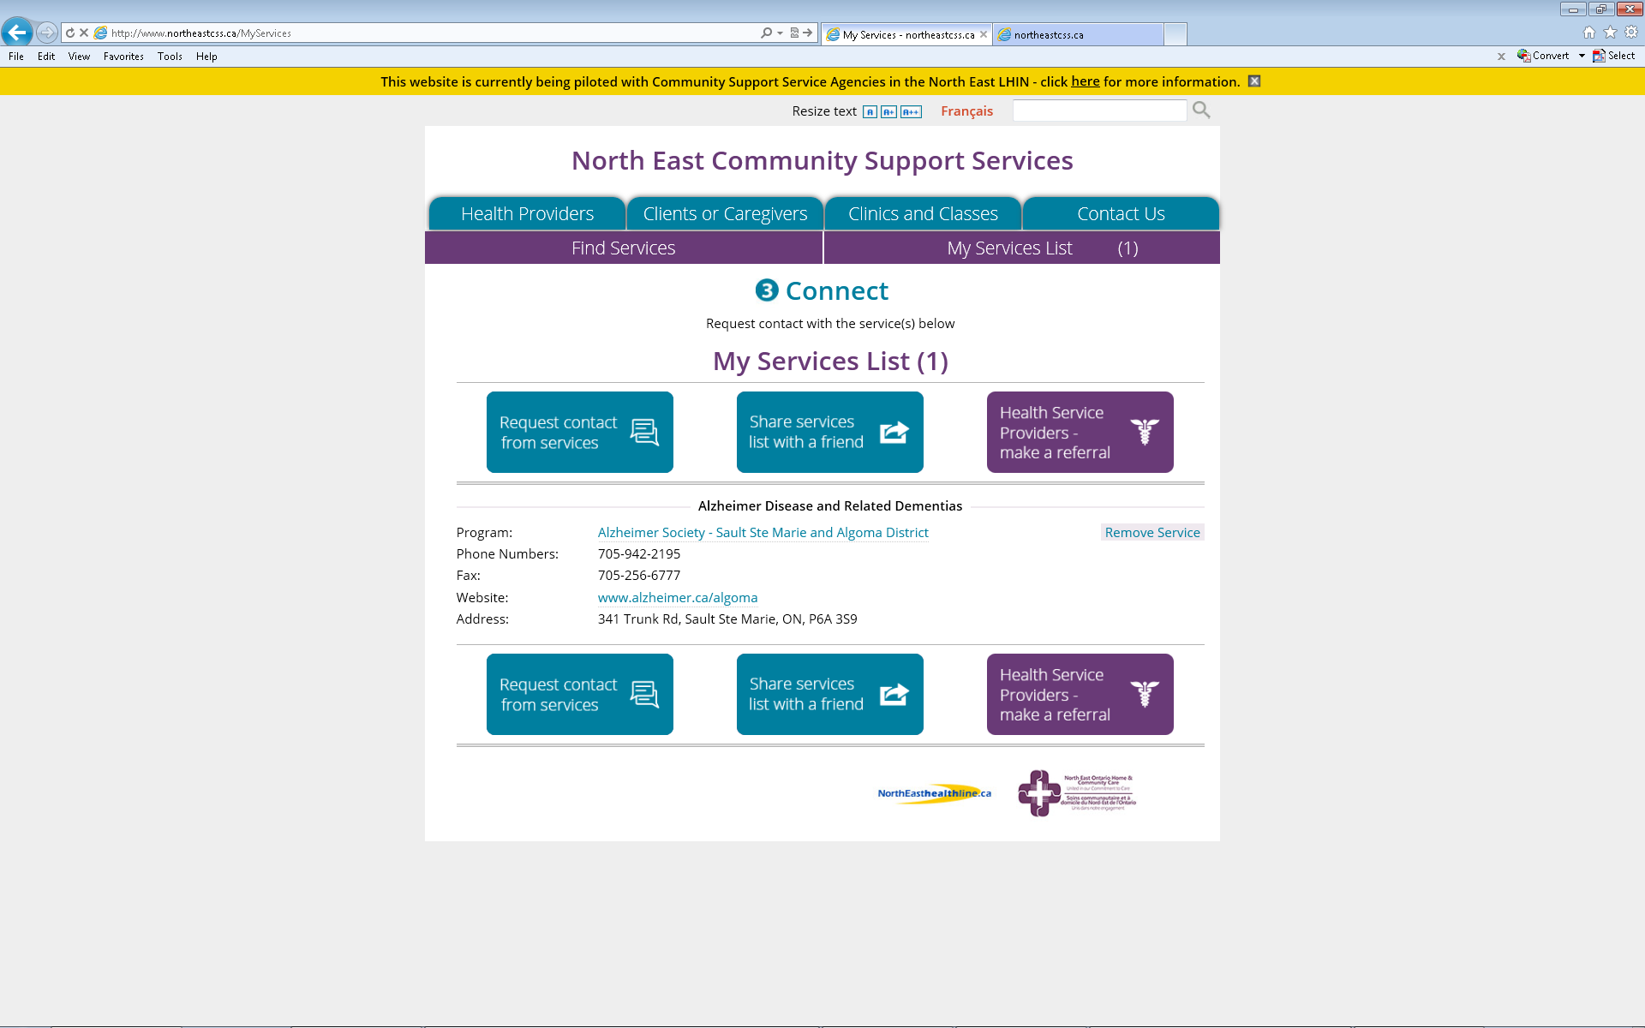
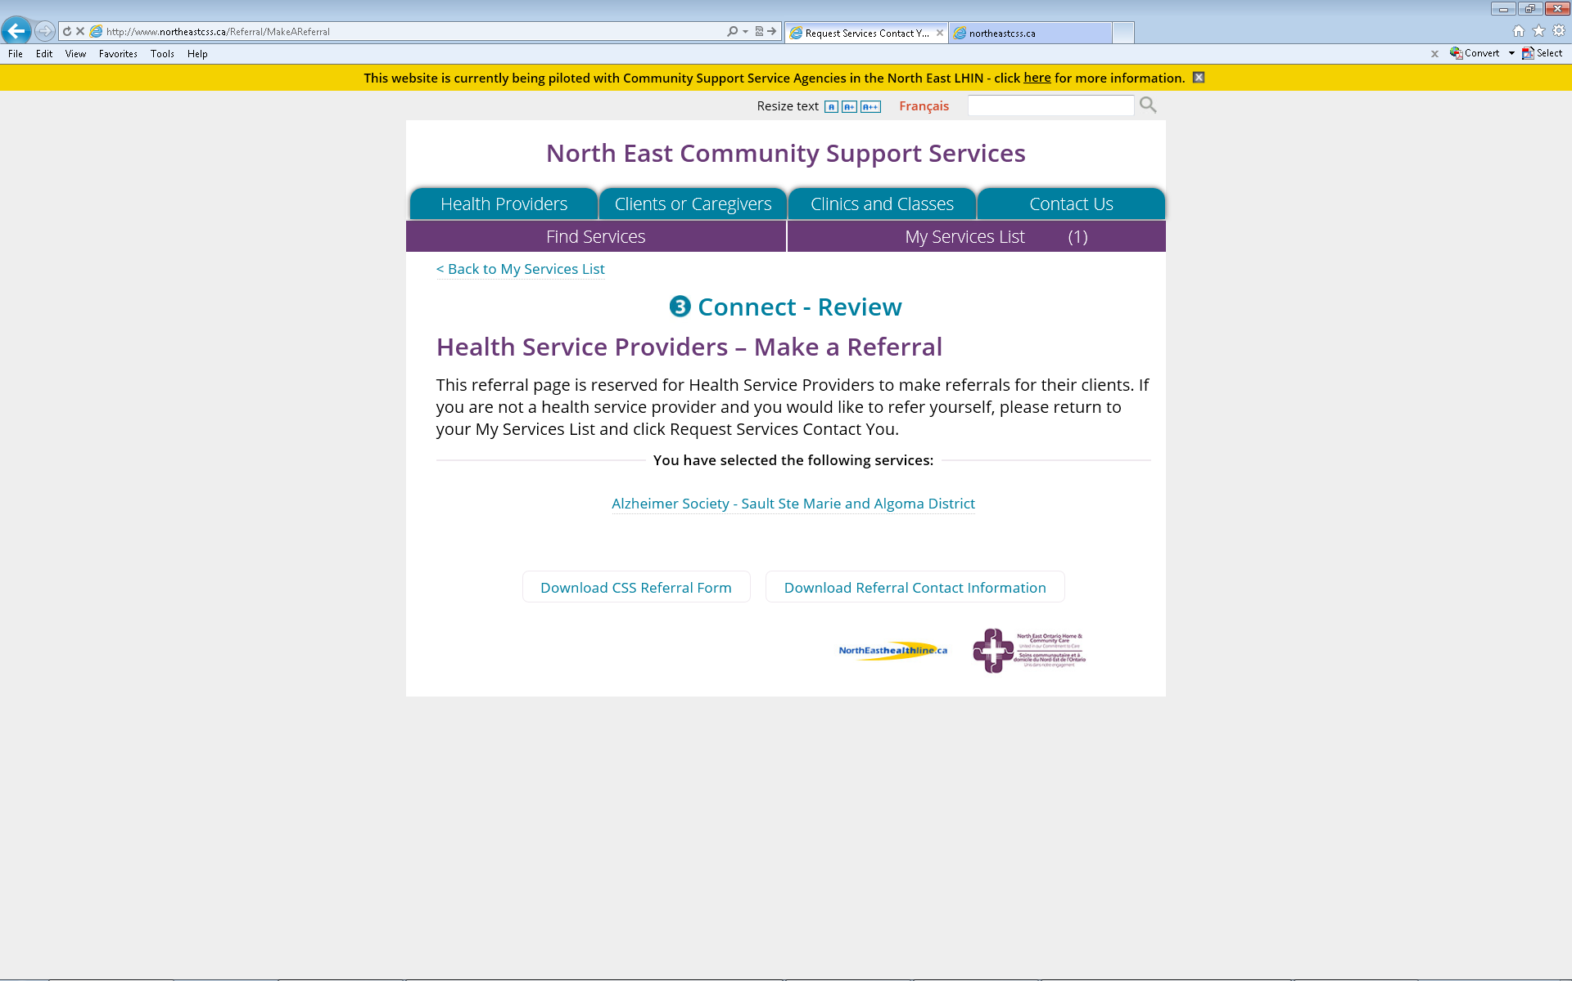
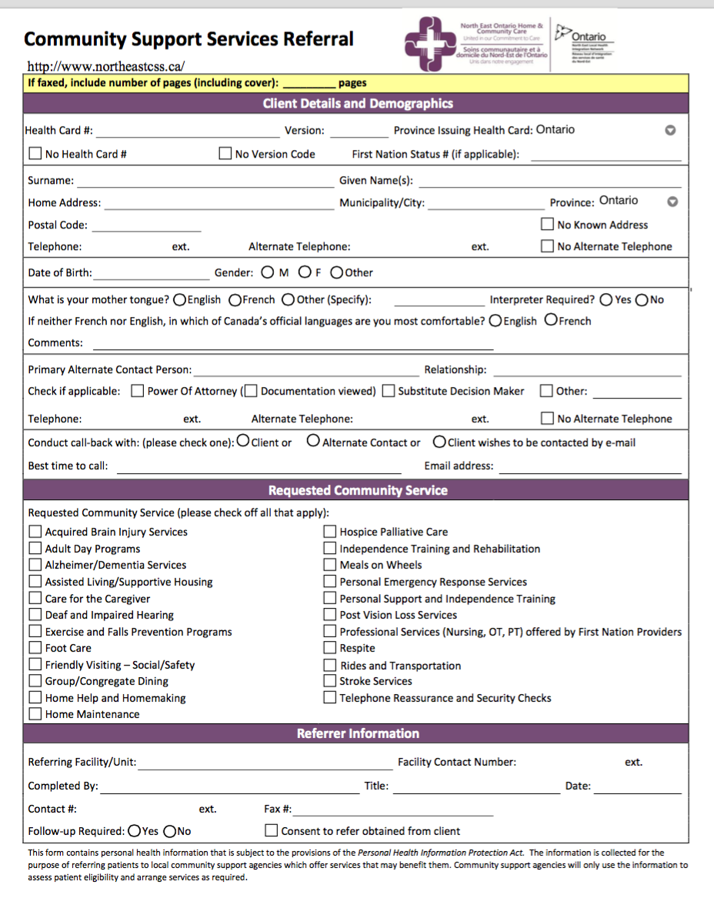
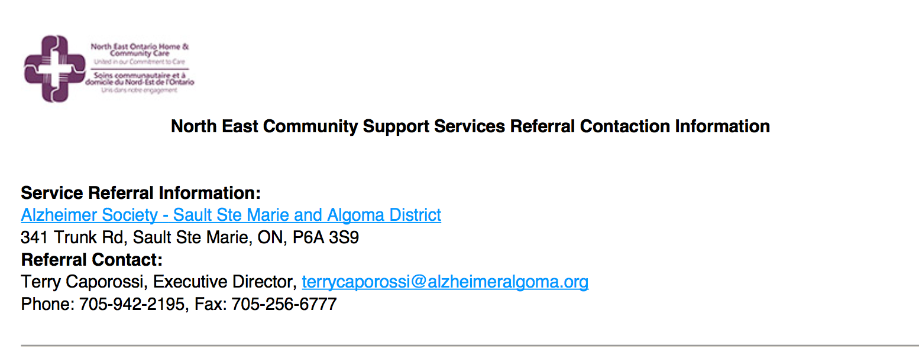
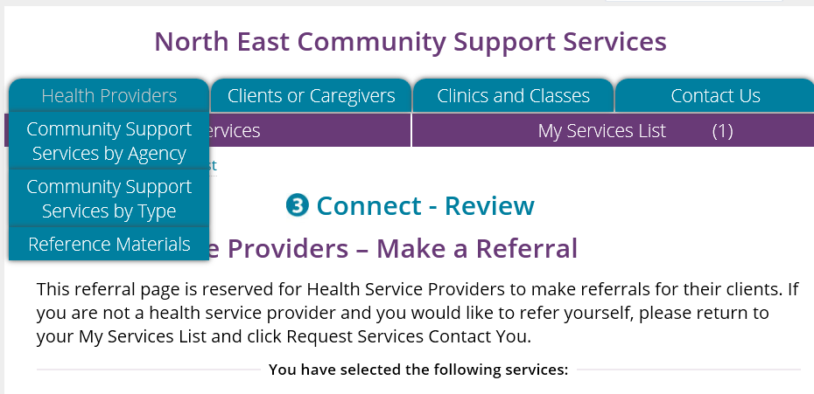
2 Pick
Click “Add to List”
It will be added to a list of services selected
Click on ‘My Services’
Connect
Click “Health Service Providers - Make a Referral”
Click on download CSS Referral Form AND
Download Referral Contact Information
Complete and print the form
Print the Referral Contact Information Form
Fax both forms to all service(s) selected
You can access training and reference
materials on the website:
http://northeastcss.ca/

